Slide 1


AMAZON STOCK PRICE PREDICTIONS
18 OCTOBER 2023
BY BULLS AND BEARS

Slide 2

TEAM MEMBERS
Sammy Sifuna
Tobias Ng’ong’a
Waruchu Kuria
Denis Kipkorir
Hellen Mwangi
Alan Omondi
Jael Akech

Slide 3

TABLE OF CONTENTS
OVERVIEW
MODELING
BUSINESS PROBLEM
CONCLUSION
RECOMMENDATION
OBJECTIVES
DATA UNDERSTANDING
LIMITATIONS
FUTURE WORK
EDA

Slide 4
OVERVIEW
Stock price prediction and analysis are important for investors and financial institutions. It involves forecasting future prices using various techniques.
Accurate stock price forecasts can have positive implications for investors and financial institutions. Stock price analysis helps investors and financial institutions make decisions about when to buy and sell shares.

Slide 5
BUSINESS PROBLEM
Stock price prediction, especially short-term, is difficult due to market volatility. Investors require precise forecasts for Amazon stock decisions.
Creating dependable models for Amazon stock prediction aids informed investor decisions. Developing accurate models and their practical application is the challenge.

Slide 6
OBJECTIVES
To build and implement different models for Amazon stock price prediction.
To evaluate the performance and accuracy of the models using MSE, RMSE, and R2 Score.
To use the best performing model to forecast Amazon stock prices.
To create a user-friendly dashboard/application for stakeholders to access predictions.

Slide 7
DATA UNDERSTANDING
The data’s features are Date, Open price, High price, Low price, Close price, Adjusted Close price, and Volume.
3,960 rows and 5 columns.
All data is numerical.
No missing values.
No duplicates.
The Date column is in DateTime format.
The data extracted ranged between 2008 and 2023.

Slide 8
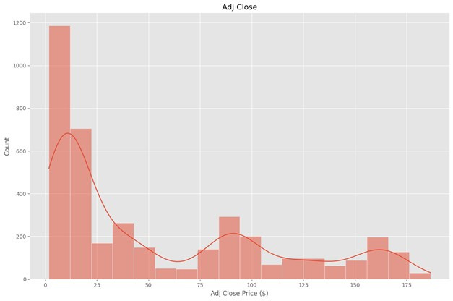
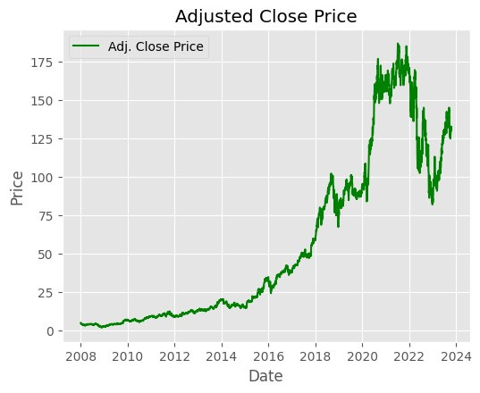
EDA
The Amazon stock price was mostly distributed 0-25 US dollars.
Amazon stock price has shown a gradual increase over the years, with a significant surge between 2018 and 2022, followed by a decline in early 2023 and a renewed increase towards the end of the year.

Slide 9
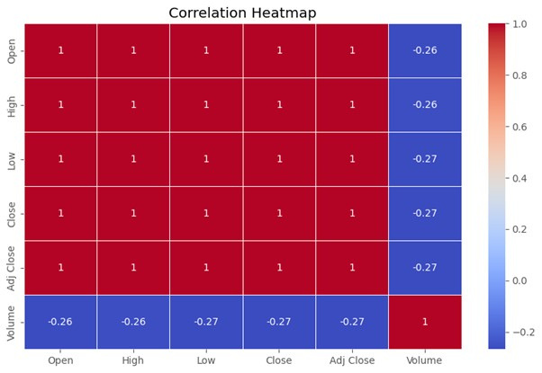
EDA (cont.)
Amazon stock price is driven by the company's performance and the overall stock market.
When the company is doing well and the stock market is up, Amazon's stock price tends to go up.

Slide 10
MODELING
Models Used
Baseline Model - SARIMA-1
Tuned model - SARIMA-2
FB Prophet
Simple Recurrent Neural Network
Long Short Term Memory(LSTM) - Original Features
LSTM - Important features

Slide 11
MODEL EVALUATION
Model | MAE | MSE | RMSE | MAPE | R2-Score
Baseline - SARIMA 1 | 0.0506 | 0.0047 | 0.0683 | 9.6815 | 0.0016
SARIMA 2 | 0.0506 | 0.0047 | 0.0683 | 9.6815 | 0.0025
FB Prophet | 0.0551 | 0.0058 | 0.0760 | 10.5142 | -0.0138
Simple RNN | 0.0779 | 0.0107 | 0.1033 | 14.7780 | -0.0471
LSTM - Original Features | 0.0779 | 0.0133 | 0.1153 | 23.1175 | -0.0025
LSTM - Important Features | 0.0779 | 0.0103 | 0.1013 | 14.9543 | -0.0036

Slide 12
CONCLUSIONS
The SARIMA-2 model performed the best for short-term Amazon stock price prediction.
The top 8 features that highly influenced the price predictions are Close, High, Returns, Rolling_Std, Volume, Open, ROC, and RSI.
Long-term predictions with SARIMA-2 brought wide variations.

Slide 13
RECOMMENDATIONS
Investors and financial institutions can use the model for short-term prediction of Amazon stock prices to determine the general trend.
Our deployment models can also be improved and used for predicting other stock markets.
More data is required for better performance of the LSTM model.
Carry out sentimental analysis alongside the model to factor in the impact of news and public sentiment on stock prices changes.

Slide 14
LIMITATIONS
Time series machine learning models are computationally expensive and require time to optimize.
Stock prices are also affected by external factors such as war and disease, which are difficult to predict.

Slide 15
FUTURE WORK
Incorporate external factors into models
Collect and integrate more data sources
Develop multi-market predictive models

Slide 16


Thank You!
ihellenmwangi
Karapia3
4kipkorir
JaelAkech
Ntobias1
AlanOmondiMoringa254
kuriawaruchu

